Slide 1
OOP (Java)
2. Simple Java Programs
Objectives
  give some simple examples of Java applications

Slide 2
Contents
1. Steps in Writing a Java Application
2. Hello.java
3. A Better Programming Environment?
4. Comparison.java

Slide 3
1. Steps in Writing a Java Appl.
text file holding the application
Foo.java
javac Foo.java
call the Java compiler
Foo.class
class file holding
Java bytecodes
java Foo
execute the class using
the Java runtime system
(the JVM)

Slide 4
2. Hello.java
import java.io.*;
public class Hello
{
public static void main(String args[])
{
System.out.println(“Hello Andrew”);
}
} // end of class

Slide 5
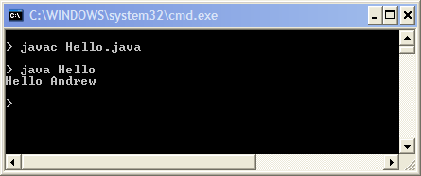
Compile & Run

Slide 6
Notes
import imports pre-defined classes from the java.io package
  * means “all classes”
All Java applications must have a main() function (method)
  static means the method is ‘inside’ the class
  public means the method can be called from outside the class
  args[] stores command line arguments (not used here)
continued

Slide 7
The Java file (e.g. Hello.java) must contain a public class with the file’s name (e.g. Hello class).
continued

Slide 8
System.out is the standard output stream
  like cout (C++) or stdout (C)
System.out.println() is the main print function (method) in Java.
writes to screen
via output stream
Hello
main() calls
System.out.println(…)

Slide 9
3. A Better Programming Environment?
When first learning Java, it is best to use a simple programming environment
  it forces you to understand how the language works
I write/compile/execute my programs using a simple configuable text editor called Notepad++
  see http://notepad-plus-plus.org/
continued

Slide 10
Useful Notepad++ features
  it will format Java code automatically
  colour-coded display of code
  it is possible to add calls to javac, java
  to the Notepad++ menu
    no need to leave the editor to compile/run
  there is an optional window that show the output from running Java code

Slide 11
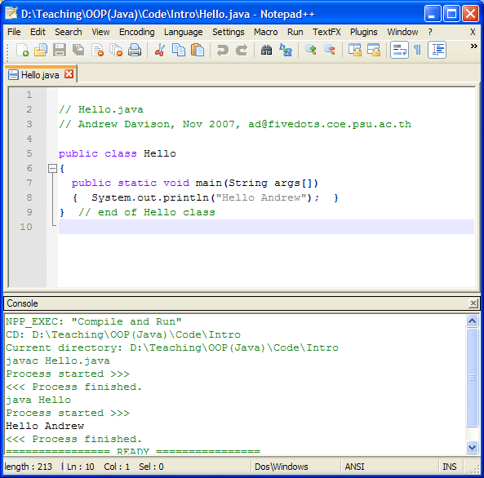

Slide 12
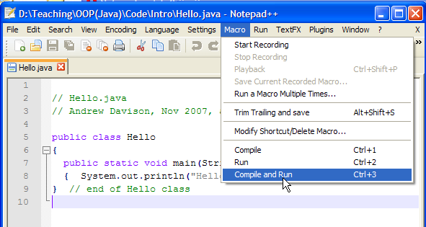
Notepad++ Macro Menu
Read the Notepad++Java.pdf document

Slide 13
4. Comparison.java
import javax.swing.JOptionPane; // GUI dialogs
public class Comparison
{
public static void main( String args[] )
{ String firstNumber,secondNumber,result;
int number1,number2;
// read user numbers
firstNumber = JOptionPane.showInputDialog(
"Enter first integer:");
secondNumber = JOptionPane.showInputDialog(
"Enter second integer:" );
:

Slide 14
// convert numbers
number1 = Integer.parseInt( firstNumber );
number2 = Integer.parseInt( secondNumber );
result = "";
if ( number1 == number2 )
result = number1 + " == " + number2;
if ( number1 != number2 )
result = number1 + " != " + number2;
if ( number1 < number2 )
result = result + "\n" +
number1 + " < " + number2;
if ( number1 > number2 )
result = result + "\n" +
number1 + " > " + number2;
if ( number1 <= number2 )
result = result + "\n" +
number1 + " <= " + number2
:

Slide 15
if ( number1 >= number2 )
result = result + "\n" +
number1 + " >= " + number2;
// Display results
JOptionPane.showMessageDialog(
null, result, "Comparison Results",
JOptionPane.INFORMATION_MESSAGE );
} // end of main()
} // end of Comparison class

Slide 16
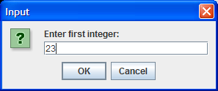
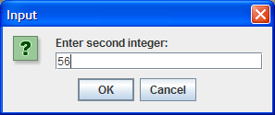
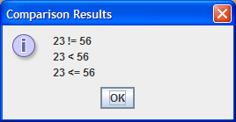
Compile & Run
$ javac Comparison.java
$ java Comparison
$

Slide 17
Notes
The Comparison class is just a single main() function (method)
continued

Slide 18
showInputDialog() and showMessageDialog() are simple (but quite flexible) methods for reading/writing input in dialog boxes
  defined inside the JOptionPane class
continued

Slide 19
Notice the use of familiar C/C++ control structures (e.g. if, while) and data types (e.g. int, double)
“...” + “...” means concatenation
(put strings together)
String is a pre-defined class for strings.
int is a built-in type (just like C’s int).

Slide 20
Calling Methods
Methods are defined in classes.
Syntax for calling a method:
Class.method-name
  or object.method-name
  e.g. JOptionPane.showMessageDialog(...);
    this calls the showMessageDialog() method in the class JOptionPane
Classes start
with an upper
case letter.

Slide 21
The Integer Class
int is a C-like built-in type
Integer is a Java class for integers
  used when integer methods are required
    Integer.parseInt() converts a string to int

Slide 22
Classes as Libraries
One way of using a class is as a library for useful methods.
  the JOptionPane class has many methods for creating different kinds of dialog boxes;
  the Integer class has many methods for manipulating integers

